Slide 1

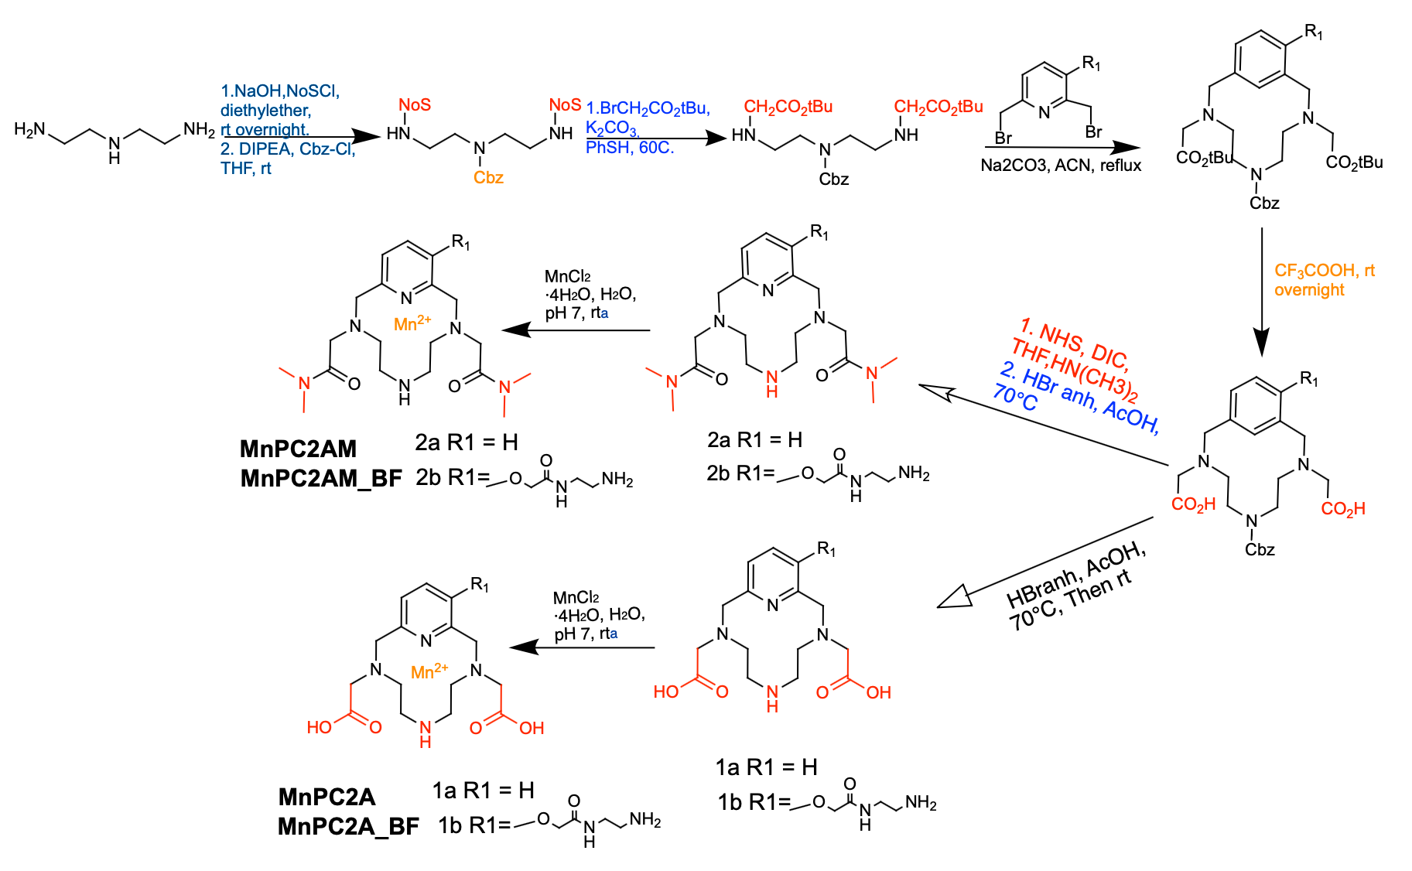
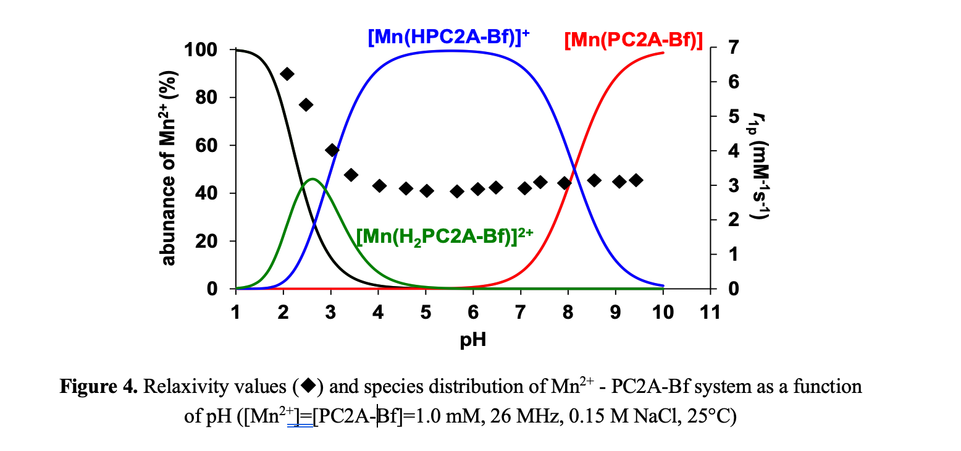
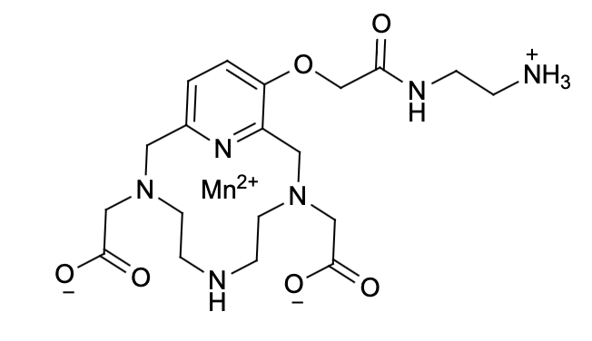
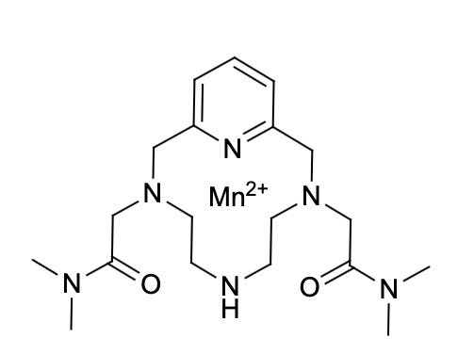
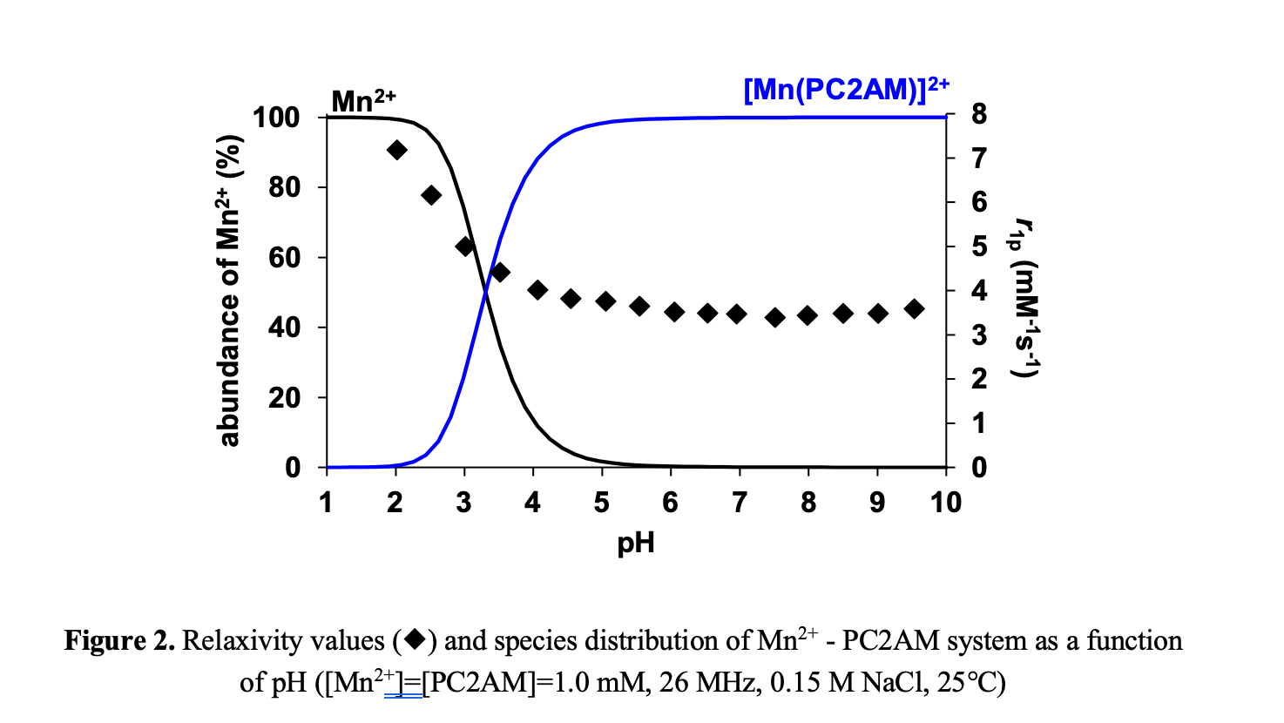
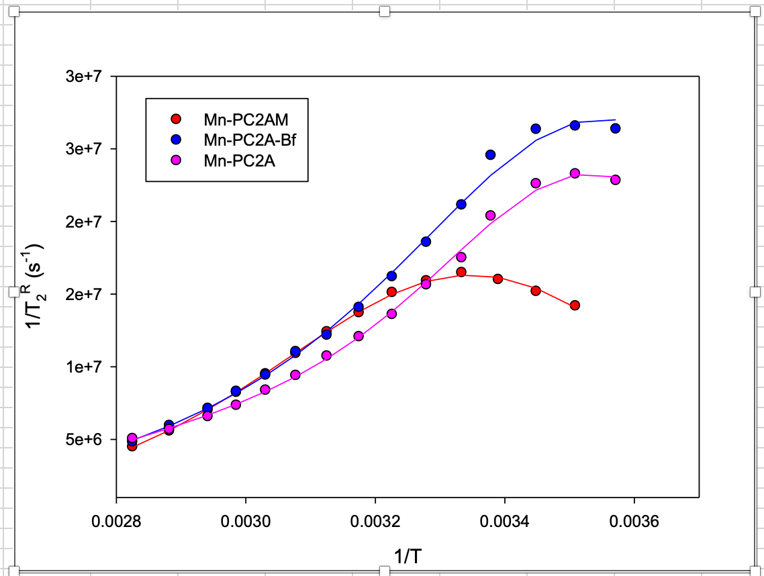
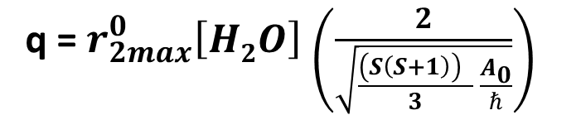
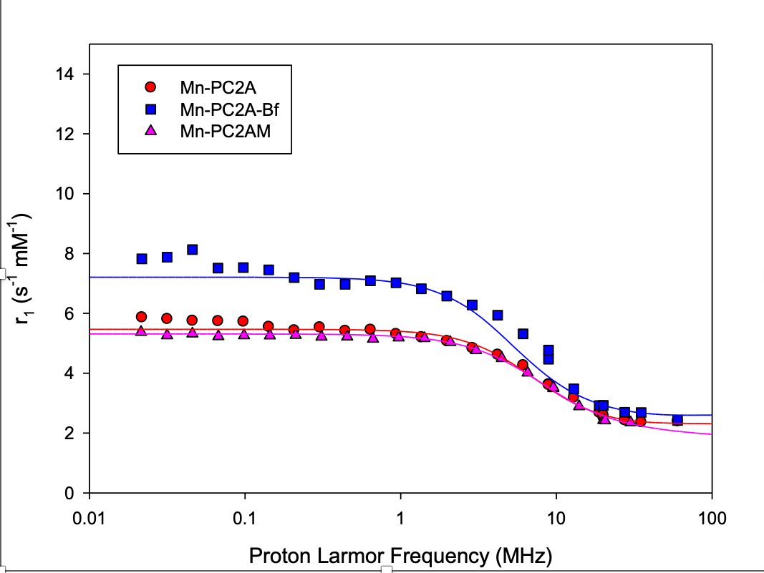




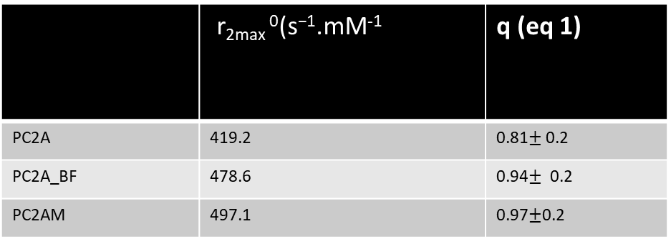
Investigation of Physico-Chemical Properties of Manganese(II)-Complex for the Conjunction with Silica Nanoparticles
Guru kiran K R¹, Céline Henoumont², Sophie laurent³
General, Organic and Biomedical Chemistry, NMR and Molecular Imaging Lab.
University of Mons, 7000, Belgium.
Introduction:
Mn(II) complexes are promising alternatives to Gd(III)-based contrast agents in MRI applications. This study explores the physico-chemical properties of Mn(II) complexes with the hexadentate PC2A and PC2AM and their bifunctional derivatives (PC2A-Bf and PC2AM-Bf), focusing on their synthesis, thermodynamic properties, kinetic inertness, and relaxation enhancement.
Synthesis
Thermodynamic properties
Protonation constants of ligands, stability (logK_{ML}) and protonation constants (logK_{MHiL}) and conditional stability constant (pM) of Ca(II), Zn(II), Cu(II) and Mn(II) complexes (0.15 M NaCl, 25°C)
H⁺ + H_{i-1}L H_{i}L
 | PC2A | PC2A-Bf | PC2AM
logK₁^{H} | 12.25ª/12.50^{b} | 11.94 (2) | 10.35 (6)^{c}
logK₂^{H} | 5.97ª/5.75^{b} | 9.26 (2) | 5.40 (7)^{c}
logK₃^{H} | 3.47ª/3.28^{b} | 5.99 (3) | −
logK₄^{H} | 1.99ª/2.38^{b} | 2.92 (3) | −
ΣlogK_{i}^{H} | 18.22ª/18.25^{b} | 31.07 | 15.75
logK_{CaL} | 9.92ª /10.0^{b} | 10.02 (7) | 7.23 (8)
logK_{CaHL} | 5.08ª | 9.00 (5) | −
logK_{ZnL} | 19.49ª | 20.40 (8) | 14.73 (8)
logK_{ZnHL} | 2.74ª | 8.68 (5) | −
logK_{CuL} | 23.58ª | 22.24 (5) | 18.15 (2)
logK_{CuHL} | 2.12ª | 8.65 (7) | −
logK_{MnL} | 17.09ª | 17.79 (6) | 12.44 (8)
logK_{MnHL} | 2.14ª | 8.13 (4) | −
pMn^{d} | 8.64ª | 8.59 | 7.25
M²⁺ + L ML
MH_{i-1}L + H⁺ MH_{i}L
logK₁^{H} value of PC2A and PC2A-BF are very similar and significantly higher than that of PC2AM due to the substitution of the carboxylate with a neutral amide functions
Second protonation of the PC2A-BF takes place on the distant amino N donor atom of the pendant arm.
Stability constants of the Ca(II)-, Zn(II)-, Cu(II)- and Mn(II)-complexes with PC2A and PC2A-BF are very similar and significantly higher than those of PC2AM complexes.
Distant amino N donor atom of the pendant arm in M(PC2A-BF) complexes does not take place in the coordination of the metal ions (logK_{MHL} values of M(PC2A-BF) complexes are similar to that of the logK₂^{H} value of the free ligand).
Conditional stability constants of Mn(II) complexes (pMn) with PC2A and PC2A-BF are similar and higher by 1.5 logK unit than that of Mn(PC2AM) due to the coordination of the neutral amide functions.
ª Ref. Z. Garda et al., Inorg. Chem. 2021, 60, 1133−1148 (0.15 M NaCl, 25°C); ^{b} Ref. W. Kim et al. Inorg. Chem. 1995, 34, 2225−2232 (0.1 M KCl, 25°C); ^{c}by spectrophotometry (I=[NaCl]+[HCl]=0.15 M, [H⁺]≤0.15 M, 25°C); ^{d}pMn=-log[Mn²⁺]_{free}, [Mn²⁺]_{t}=[L]_{t}=10 μM, pH=7.4, 25°C
Kinetic Inertness
Relaxation enhancement
Mechanism :
[MnL]_{t}=[MnL] + [Mn(HL)]
Pseudo-first-order rate constants (k_{d}) characterize the transmetallation reaction between [Mn(PC2AM)]²⁺ and Cu²⁺ as a function of pH and [H⁺] ([Mn(PC2AM)]=0.1 mM, [Cu²⁺]=1.0 (), 2.0 (), 3.0 () and 4.0 mM (), 0.01 M NMP, 0.15 M NaCl, 25°C)
Rate (k_{i}) and equilibrium (K_{i}) constants and half-life (t_{1/2}=ln2/k_{d}) values characterizing the transmetalation reactions of the Mn(II) complexes with PC2A, PC2A-Bf, PC2AM
MnL + Cu²⁺ CuL + Mn²⁺
 | [Mn(PC2A)] | [Mn(PC2A-Bf)] | [Mn(PC2AM)]²⁺
k₀ (s⁻¹) ª | − | − | −
k₁ (M⁻¹s⁻¹) ^{b} | 33 ± 1.5 / 221^{c} | 24 ± 1 | 6.9 ± 0.2
logK_{Mn(HL)} | 2.35 (8) / 3.55 ^{c} | 2.25 (9) | 2.93 (6)
k_{d} (s⁻¹) at pH=7.4 | 1.3110⁻⁶ / 9.1710^{-6 c} | 9.6910⁻⁷ | 2.7410⁻⁷
t_{1/2} (s⁻¹) at pH=7.4 | 147 / 21 ^{c} | 198 | 703
L= PC2A, PC2A-Bf, PC2AM
Pseudo-first-order condition: [MnL] <<[Cu²⁺]
[MnL]=0.1 mM; [Cu²⁺]=1.0 – 4.0 mM; [MCA]=[NMP]=0.01 M; [NaCl]=0,15M; 25°C
¹⁷O NMR & NMRD
ª Fixed to 0 for the data fitting; ^{b} k₁=k_{Mn(HL)}K_{Mn(HL)}; ^{c} Ref. Z. Garda et al., Inorg. Chem. 2021, 60, 1133−1148 (0.15 M NaCl, 25°C)
Conclusion
The substitution of the carboxylate with amide functions results in the decrease of the protonation constant of PC2AM ligand
The distant amino-N donor atom of the pendant arm in M(PC2A-BF) complexes does not take place in the coordination of the metal ions.
The physico-chemical properties of the Mn(II) complex with PC2A and PC2A-BF ligands are very similar.
Surprisingly, the kinetic inertness of the [Mn(PC2AM)]²⁺ complex is about 4 times higher than that of the parent [Mn(PC2A)] complex due to the slower acid catalyzed dissociation.
Relaxation properties of the Mn(II)-complexes with PC2A, PC2A-BF and PC2AM are very similar.
 | r_{2max} ⁰(s⁻¹.mM⁻¹ | q (eq 1)
PC2A | 419.2
PC2A-Bf | 478.6
PC2AM | 497.1
 | PC2A | PC2A-BF | PC2AM
d_{NMR}(nm) | 0.36 | 0.36 | 0.36
D (m²·s⁻¹)^{b} | 3.3 × 10⁻⁹ | 3.3 × 10⁻⁹ | 3.3 × 10⁻⁹
r (nm) | 0.28 | 0.28 | 0.28
τ_{R} (ps) | 48.7 ± 3.8 | 59 ± 0.6 | 35.4
τ_{M} (ns) | 6.5 | 6.35 | 8.20
τ_{SO} (ps) | 119 ± 19.2 | 272 ± 6760.0 | 241± 10.3
τ_{v} (ps) | 5.7 ± 1.2 | 3.1 ± 61.6 | 12.3± 53.1
q | 1 | 1 | 1
r₁ at 20 MHz | 2.6 | 2.9 | 3.7
Acknowledgements
Prof. Sophie Laurent.
Dr. Céline Henoumont
This project is funded by European Union HORIZON-MSCA-DN-2021,
project FC-RELAX no. 101072758

